Slide 1
Date: | Human Biology Year 12 ATAR
Do Now Complete the past exam question given, open book, using your review worksheet and any handwritten notes. Lesson Agenda 1: Do Now 2: Synapses and Neurotransmitters – ppt presentation 3: Work on Review Worksheet: Synapses and Neurotransmitters 4: Lesson summary and wind-up Suggested Study Compulsory: Complete review worksheet, mark and correct using answer key on Connect. Read through today’s notes and textbook section Write out the steps involved in transmission across the synapse. NEXT LESSON Past Exam Question Divisions of the nervous system | Learning Aims Define the terms synapse, neurotransmitter and neuromuscular junction. List some common neurotransmitters Describe the sequence of events in the transmission of an action potential across the synapse. Describe the differences in action between excitatory and inhibitory neurotransmitters Describe similarities and differences between a synapse and a neuromuscular junction Discuss how stimulants, depressants and neurotoxins affect the transmission at the synapse and/or NMJ
 | Key Vocabulary Action Potential Vesicle Neurotransmitter Threshold Neuromuscular junction

Slide 2

Synapses and Neurotransmitters
Chapter 3: Nerve Cells and Nerve Impulses

Slide 3
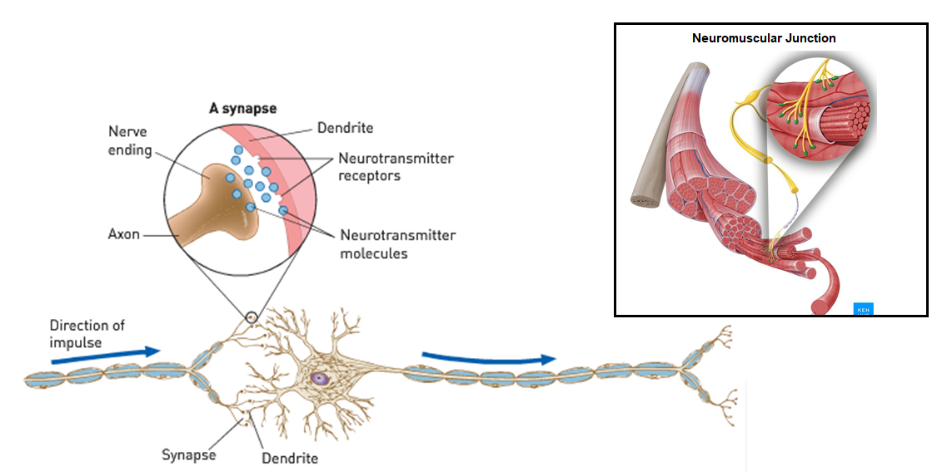
Synapses and Neurotransmitters Overview
Synapse: a small gap between one neuron and the next.
Messages passed across the gap by release of chemicals called neurotransmitters.
Neuromuscular junction: where an axon terminal meets muscle tissue instead of another neuron – impulses passed from nerve to muscle, triggering contraction.
Learning Aim: Define the terms synapse, neurotransmitter and neuromuscular junction.

Slide 4
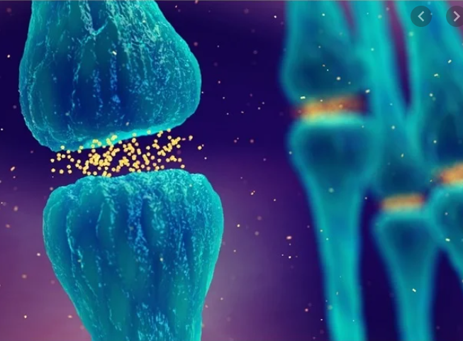
Neurotransmitters
Released from the axon terminals in response to action potential
Diffuse across the synapse
Attach to receptors on the dendrite of next neuron
Include chemicals such as:
Acetylcholine (ACh)
Noradrenalin (Norepinephrine)
Adrenaline (Epinephrine)
Dopamine
Histamine
Adenosine
Serotonin
Learning Aim: List some common neurotransmitters.

Slide 5
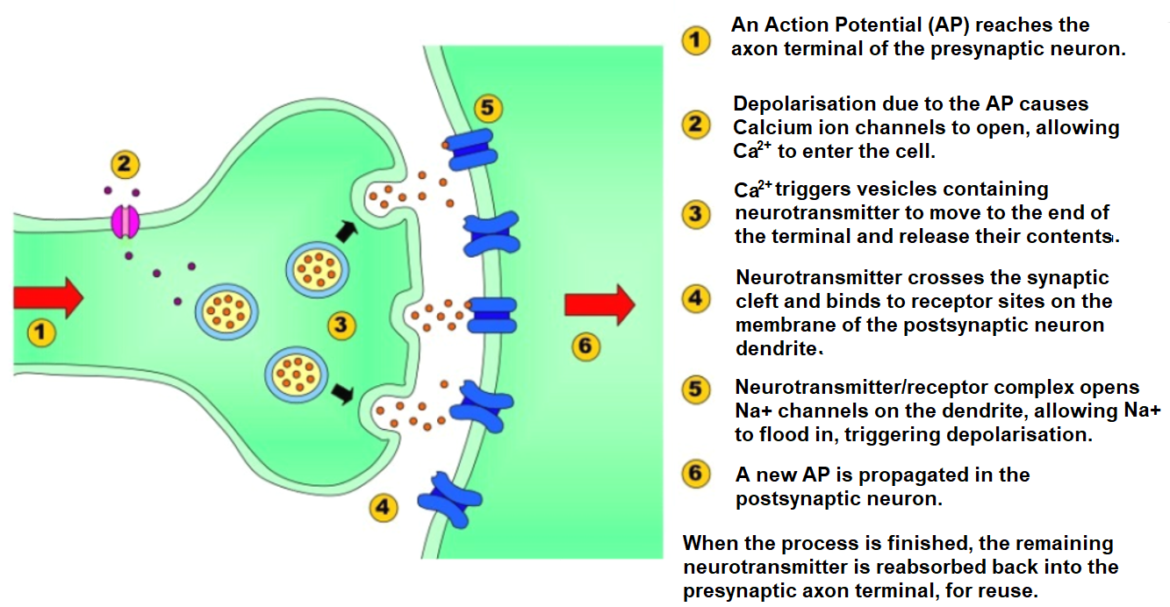
Transmission of an Action Potential (AP) across the synapse
Learning Aim: Describe the sequence of events in the transmission of an action potential across a synapse.

Slide 6
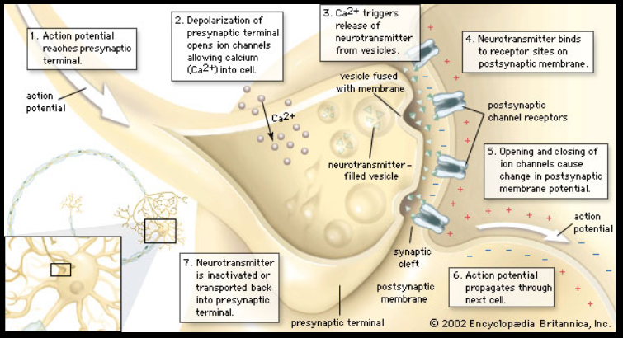
Another diagram view…

Slide 7
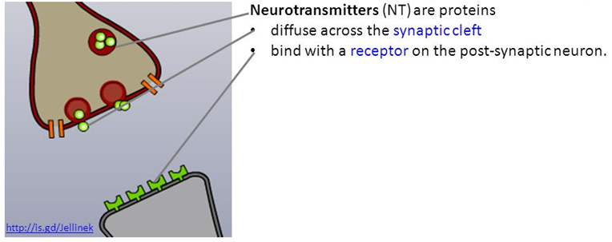
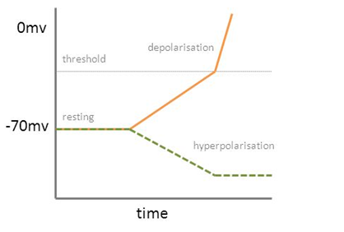
Whether or not the post-synaptic neuron propagates the AP depends on:
Which NT diffuses across
Which receptors it binds to
Which ions flow in/out of the post-synaptic neuron
Whether or not depolarisation reaches threshold
Excitatory NTs cause depolarisation
NT binds, Na+ channels open, Na+ rushes in.
Post-synaptic membrane potential depolarises
AP propagated.
Inhibitory NTs cause hyperpolarisation
NT binds.
Either K+ channels open and K+ rushes out
OR Cl- channels open, Cl- rushes in.
Membrane potential becomes more negative – hyperpolarisation occurs.
This means membrane potential is further from the threshold.
AP is initiated more slowly, or prevented entirely.
Note: some NTs are excitatory at some synapses and inhibitory at others. More on this later – it really depends on what receptors are on the post-synaptic membrane.
Learning Aim: Describe differences in action between excitatory and inhibitory neurotransmitters.

Slide 8
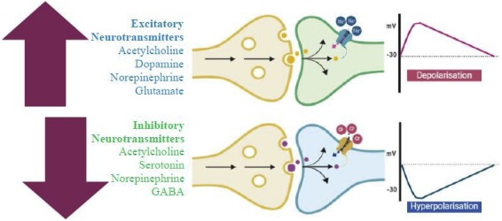

Slide 9
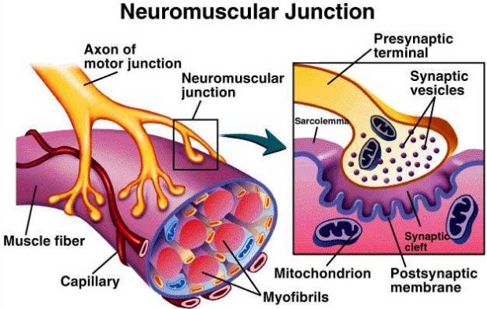
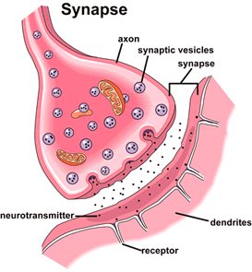
 | Synapse | NMJ
Similarities | Excitable cells separated by synaptic cleft.
 | Axon terminals store and release neurotransmitter.
 | Binding of NT to receptors on the post-synaptic membrane opens ion channels, altering membrane potential.
Differences | Junction between 2 neurons. | Junction between neuron and skeletal muscle fibre.
 | Can be excitatory or inhibitory. | Only excitatory (any inhibition occurs in synapses further up the chain)
Learning Aim: Define the terms synapse, neurotransmitter and neuromuscular junction.

Slide 10
Other chemicals can affect the transmission at the synapse or neuromuscular junction, eg:
Stimulants
Can stop inhibitory neurotransmitters from working, so threshold is reached more easily, having a stimulant effect.
EG: Caffeine
Can increase the release of an excitatory neurotransmitter from the pre-synaptic neuron, causing increased neurotransmission:
EG: Amphetamines, Ephedrine, Pseudoephedrine, MDMA (ecstasy)
Can prevent re-uptake of neurotransmitter from the synaptic cleft, meaning it hangs around longer, and continues to stimulate the post-synaptic neuron:
EG: SSRIs used to treat clinical anxiety and depression
Can increase the action of post-synaptic receptors, meaning that transmission occurs more easily.
EG: Nicotine
Learning Aim: Discuss how stimulants, depressants and neurotoxins affect the transmission at the synapse or NMJ

Slide 11
Depressants
Can work in a variety of different ways. Examples include:
Can increase the effects of an inhibitory neurotransmitter, increasing hyperpolarisation of the post-synaptic neuron
EG: Alcohol, Valium (benzodiazepine)
Can block or inhibit an AP by blocking ion channels in the post-synaptic neuron.
EG: Anaesthetics
Neurotoxins
Can work in a variety of different ways. Examples include:
Prevention of breakdown of a neurotransmitter at a synapse, causing persistent stimulation
EG: organophosphates (snail bait and others) prevent breakdown of ACh.
Increasing the efficiency of post-synaptic receptors
EG: alkaloids such as strychnine.
Learning Aim: Discuss how stimulants, depressants and neurotoxins affect the transmission at the synapse or NMJ

